Slide 1
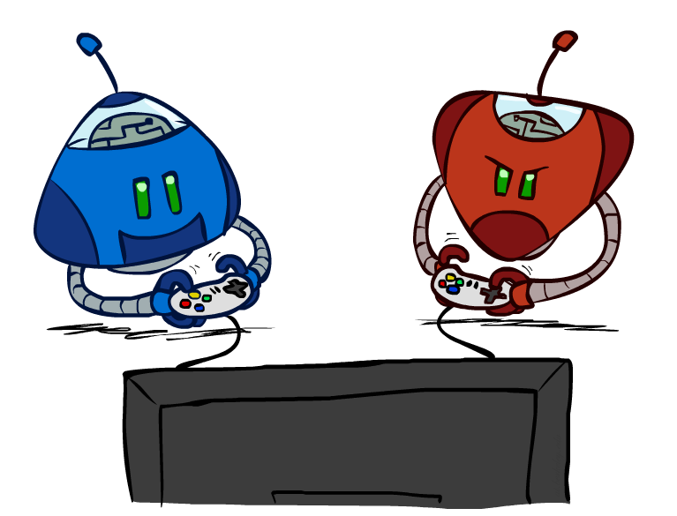
CS 188: Artificial Intelligence
Search with Other Agents
Instructor: Anca Dragan
University of California, Berkeley
[These slides adapted from Dan Klein and Pieter Abbeel]
Notes:
Please retain proper attribution, including the reference to ai.berkeley.edu. Thanks!

Slide 2
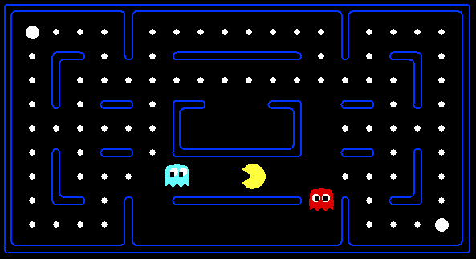
Behavior from Computation
[Demo: mystery pacman (L6D1)]
Notes:
General thing we try to do: computation that gives rise to the right behavior automatically

Slide 3

Video of Demo Mystery Pacman
Notes:
What kinds of computations must be happening here in order to give rise to this behavior

Slide 4


Agents Getting Along with Other Agents

Slide 5

Agents Getting Along with Humans

Slide 6
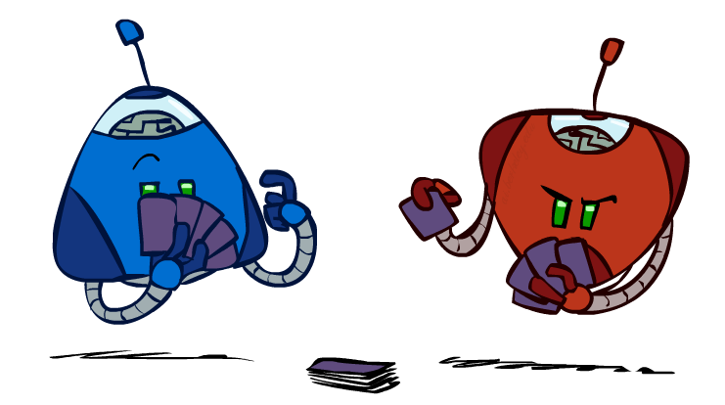
Types of Games
Many different kinds of games!
Axes:
Deterministic or stochastic?
One, two, or more players?
Zero sum?
Perfect information (can you see the state)?
Notes:
Not poker – imperfect information, stochastic
Just two players; for today, 0 sum

Slide 7
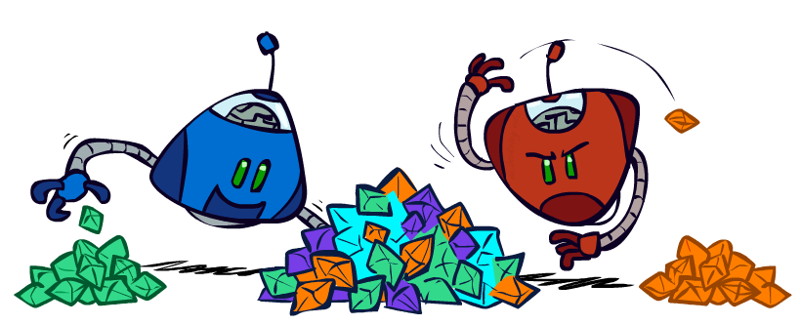
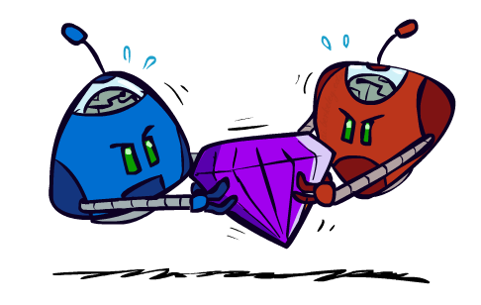
Types of Games
General Games
Agents have independent utilities (values on outcomes)
Cooperation, indifference, competition, and more are all possible
We don’t make AI to act in isolation, it should a) work around people and b) help people
That means that every AI agent needs to solve a game
Zero-Sum Games
Agents have opposite utilities (values on outcomes)
Lets us think of a single value that one maximizes and the other minimizes
Adversarial, pure competition

Slide 8

Types of Games
Common payoff games
Discussion: Use a technique you’ve learned so far to solve one!

Slide 9
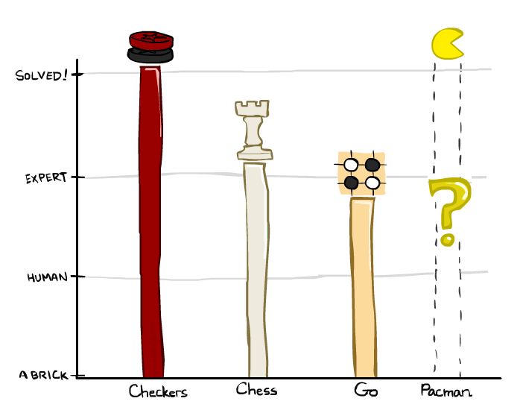
Zero-Sum Game Games ☺
Checkers: 1950: First computer player. 1994: First computer champion: Chinook ended 40-year-reign of human champion Marion Tinsley using complete 8-piece endgame. 2007: Checkers solved!
Chess: 1997: Deep Blue defeats human champion Gary Kasparov in a six-game match. Deep Blue examined 200M positions per second, used very sophisticated evaluation and undisclosed methods for extending some lines of search up to 40 ply. Current programs are even better, if less historic.
Go: Human champions are now starting to be challenged by machines, though the best humans still beat the best machines. In go, b > 300! Classic programs use pattern knowledge bases, but big recent advances use Monte Carlo (randomized) expansion methods.

Slide 10
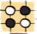
Zero-Sum Game Games ☺
Checkers: 1950: First computer player. 1994: First computer champion: Chinook ended 40-year-reign of human champion Marion Tinsley using complete 8-piece endgame. 2007: Checkers solved!
Chess: 1997: Deep Blue defeats human champion Gary Kasparov in a six-game match. Deep Blue examined 200M positions per second, used very sophisticated evaluation and undisclosed methods for extending some lines of search up to 40 ply. Current programs are even better, if less historic.
Go :2016: Alpha GO defeats human champion. Uses Monte Carlo Tree Search, learned evaluation function.
Pacman
Notes:
A solved game is a game whose outcome (win, lose or draw) can be correctly predicted from any position, assuming that both players play perfectly.

Slide 11
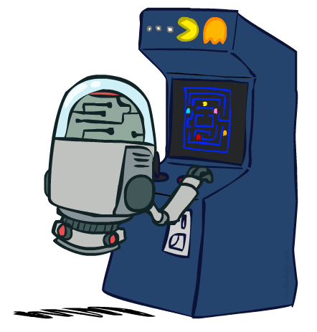
Deterministic Games with Terminal Utilities
Many possible formalizations, one is:
States: S (start at s₀)
Players: P={1...N} (usually take turns)
Actions: A (may depend on player / state)
Transition Function: SxA → S
Terminal Test: S → {t,f}
Terminal Utilities: SxP → R
Solution for a player is a policy: S → A

Slide 12
Adversarial Games

Slide 13

Adversarial Search
Notes:
Consequence of my actions; except instead of the traditional way, I am going to imagine I take an action, and then, what’s interesting is that my oponent will get to take an action, so I have to think about what they will think and what action they will pick; the way they do that is they think about me..and so on

Slide 14
188 News: Cost -> Utility!
no longer minimizing cost!
agent now wants to maximize its score/utility!

Slide 15
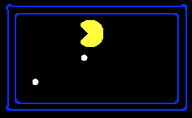
Single-Agent Trees
8
2
0
…
2
6
…
4
6
Notes:
Single agent: I can pick any leaf I want; e.g. here I go right twice

Slide 16
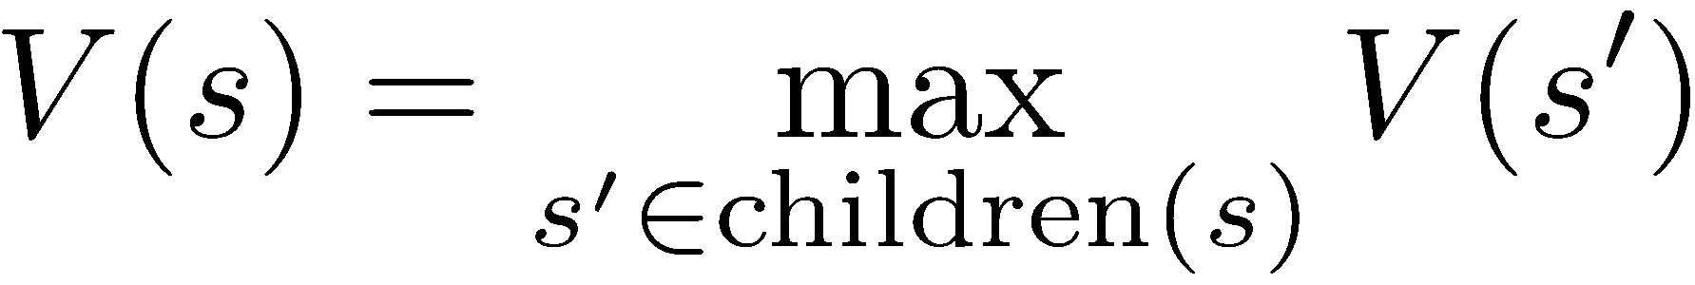
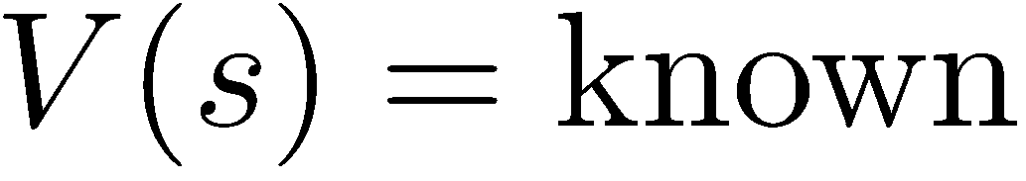
Value of a State
Value of a state: The best achievable outcome (utility) from that state
Non-Terminal States:
8
2
0
…
2
6
…
4
6
Terminal States:
Notes:
The value of this for me is 8, because I’ll be optimal. How do we get to know that? Clear at terminal nodes.

Slide 17

Adversarial Game Trees
-20
-8
…
-18
-5
…
-10
+4
-20
+8
Notes:
We have the exact same kind of branching, everyone is in agreement about what might happen
But we don’t control the other agent, and in fact we disagree with them on what we would like to do
We can’t just dictate “I want the 8” – the other agent won’t let us get to it
Need another definition of value

Slide 18
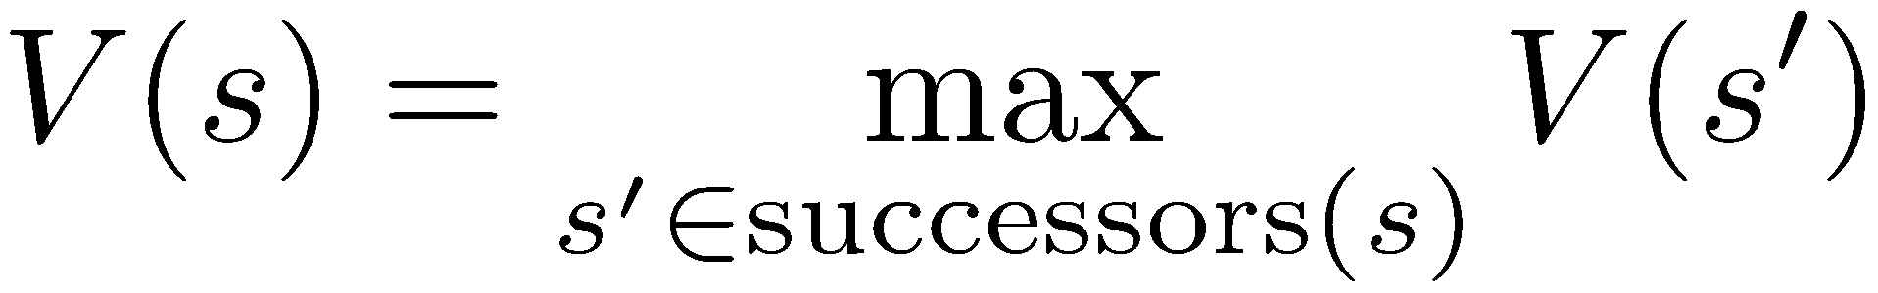
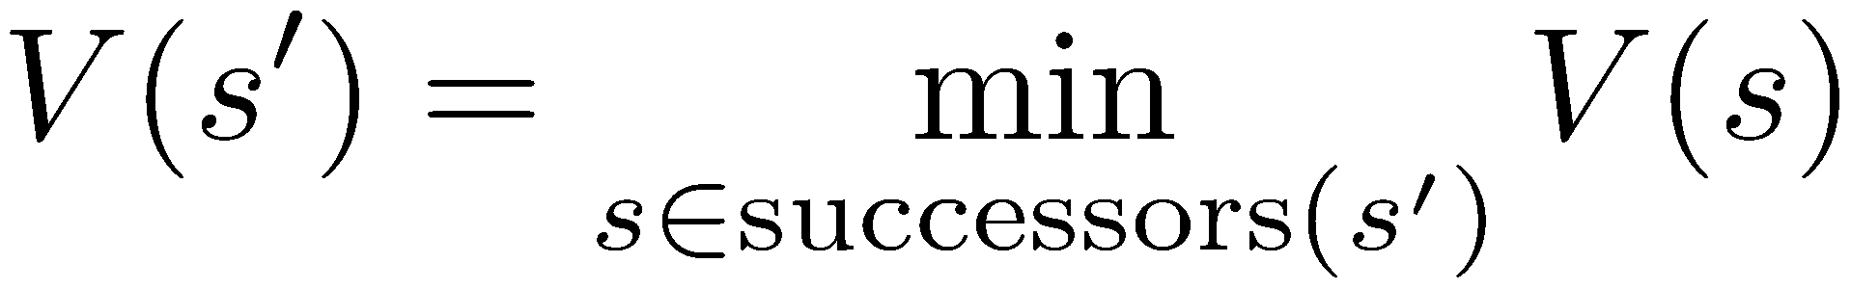
Minimax Values
States Under Agent’s Control:
States Under Opponent’s Control:
-8
-5
-10
+8
Terminal States:
Notes:
8 great, love to have it – but it’s just not going to happen; and if I’m smart, I accept that and account for it
I’m really choosing between -8 and -10;
life is much worse when there is an adversary

Slide 19

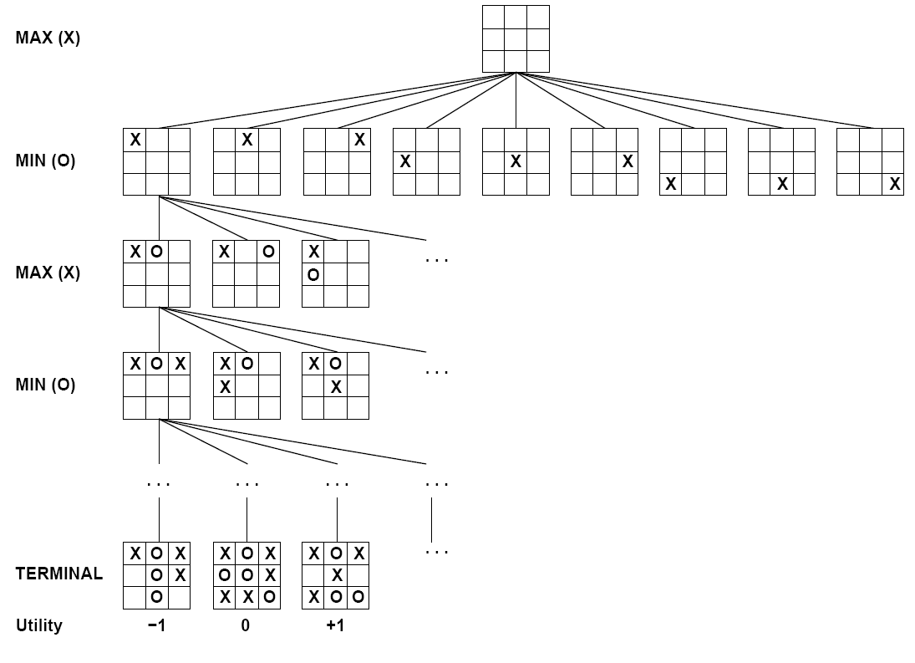

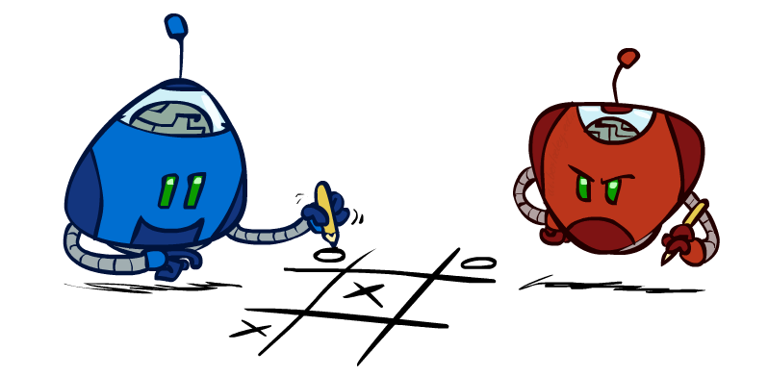
Tic-Tac-Toe Game Tree
Notes:
2nd player is going to force a draw
The value of the root is 0

Slide 20
Adversarial Search (Minimax)
Deterministic, zero-sum games:
Tic-tac-toe, chess, checkers
One player maximizes result
The other minimizes result
Minimax search:
A state-space search tree
Players alternate turns
Compute each node’s minimax value: the best achievable utility against a rational (optimal) adversary
Minimax values: computed recursively
5
max
2
5
min
8
2
5
6
Terminal values: part of the game
Notes:
The algorithm you run propagates things up the tree

Slide 21
Minimax Implementation
def max-value(state):
initialize v = -∞
for each successor of state:
v = max(v, min-value(successor))
return v
def min-value(state):
initialize v = +∞
for each successor of state:
v = min(v, max-value(successor))
return v

Slide 22
Minimax Implementation (Dispatch)
def value(state):
if the state is a terminal state: return the state’s utility
if the next agent is MAX: return max-value(state)
if the next agent is MIN: return min-value(state)
def max-value(state):
initialize v = -∞
for each successor of state:
v = max(v, value(successor))
return v
def min-value(state):
initialize v = +∞
for each successor of state:
v = min(v, value(successor))
return v
Notes:
Max: start high, keep a current estimate of the max, update it as you see more children – important later
Pick an order for two reasons: sequential processor and pruning

Slide 23
Minimax Example
3
3
2
2
3
12
8
2
4
6
14
5
2

Slide 24
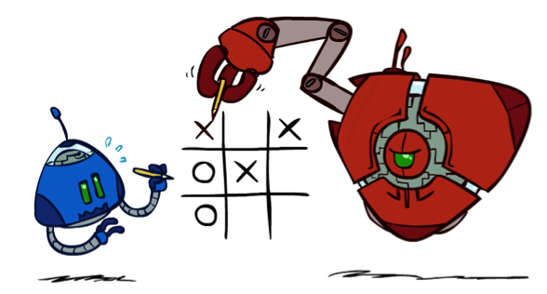
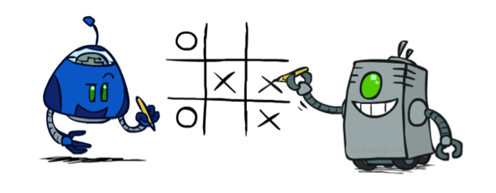
Minimax Properties
max
min
10
10
9
100
Optimal against a perfect player. Otherwise?
[Demo: min vs exp (L6D2, L6D3)]
Notes:
correct against evil mastermind; they won’t let you take the 100
What if we don’t have a perfect player? What if we have this guy? Maybe with this guy you should go for 100.
Ghost demo
Car safety discussion

Slide 25
Video of Demo Min vs. Exp (Min)
Notes:
Sorry pacman
Dive bomb the ghost is optimal, die as quickly as possible

Slide 26
Video of Demo Min vs. Exp (Exp)
Notes:
What if those ghost are not adversarial? They don’t look like masterminds.

Slide 27
Minimax Efficiency
How efficient is minimax?
Just like (exhaustive) DFS
Time: O(b^{m})
Space: O(bm)
Example: For chess, b ≈ 35, m ≈ 100
Exact solution is completely infeasible
But, do we need to explore the whole tree?
Notes:
If you could brute force your way, chess would be solved. It would probably be a draw.
Don’t play chess, just say eh, it’s a draw.

Slide 28

Resource Limits

Slide 29
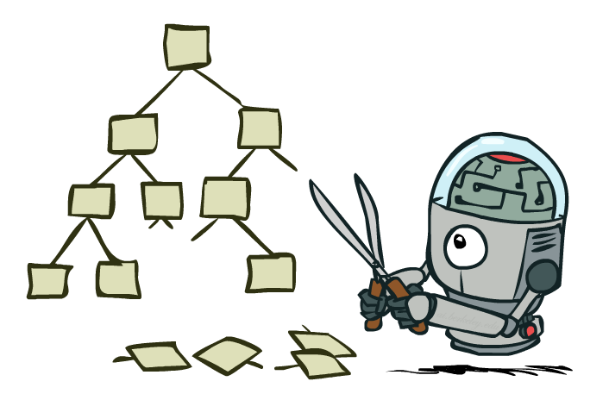
Game Tree Pruning

Slide 30
Minimax Example
3
3
<=2
2
3
12
8
2
14
5
2

Slide 31
Alpha-Beta Pruning
General configuration (MIN version)
We’re computing the MIN-VALUE at some node n
We’re looping over n’s children
n’s estimate of the childrens’ min is dropping
Who cares about n’s value? MAX
Let a be the best value that MAX can get at any choice point along the current path from the root
If n becomes worse than a, MAX will avoid it, so we can stop considering n’s other children (it’s already bad enough that it won’t be played)
MAX version is symmetric
MAX
MIN
a
MAX
MIN
n

Slide 32
Alpha-Beta Implementation
α: MAX’s best option on path to root
β: MIN’s best option on path to root
def max-value(state, α, β):
initialize v = -∞
for each successor of state:
v = max(v, value(successor, α, β))
if v ≥ β return v
α = max(α, v)
return v
def min-value(state , α, β):
initialize v = +∞
for each successor of state:
v = min(v, value(successor, α, β))
if v ≤ α return v
β = min(β, v)
return v
Notes:
If we’re min, we are evaluating our options, and the best we can do keeps decreasing as we see more children
If we ever reach a value where we would force something smaller than a choice that max can force, alpha, then we just give up and return that -- we don’t bother going further; max is never going to let us get here, max is going to force the path to alpha instead
if however we find that this is an option that

Slide 33
Alpha-Beta Pruning Properties
This pruning has no effect on minimax value computed for the root!
Values of intermediate nodes might be wrong
Important: children of the root may have the wrong value
So the most naïve version won’t let you do action selection
Good child ordering improves effectiveness of pruning
With “perfect ordering”:
Time complexity drops to O(b^{m/2})
Doubles solvable depth!
Full search of, e.g. chess, is still hopeless…
This is a simple example of metareasoning (computing about what to compute)
max
min
10
10
0

Slide 34
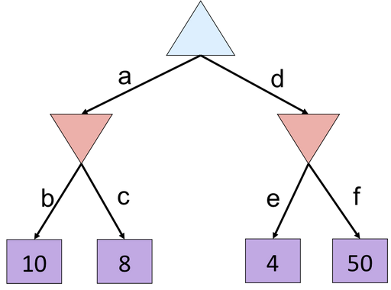
Alpha-Beta Quiz
Notes:
f

Slide 35
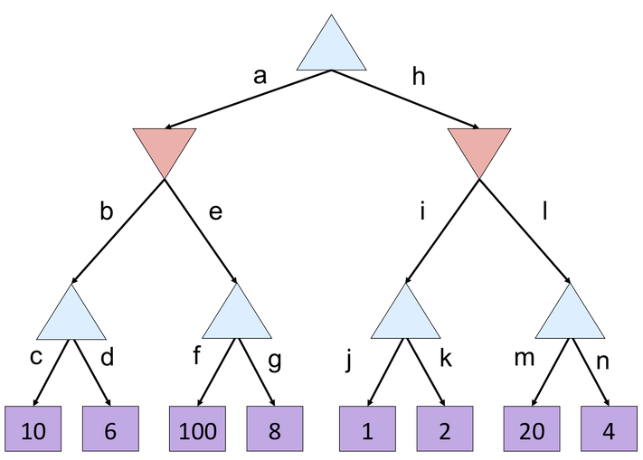
Alpha-Beta Quiz 2
2
Notes:
G, m,n

Slide 36
Alpha-Beta Quiz 2
10
<=2
>=100
2
10
Notes:
G, m,n

Slide 37
Resource Limits

Slide 38
Resource Limits
Problem: In realistic games, cannot search to leaves!
Solution: Depth-limited search
Instead, search only to a limited depth in the tree
Replace terminal utilities with an evaluation function for non-terminal positions
Example:
Suppose we have 100 seconds, can explore 10K nodes / sec
So can check 1M nodes per move
α-β reaches about depth 8 – decent chess program
Guarantee of optimal play is gone
More plies makes a BIG difference
Use iterative deepening for an anytime algorithm
max
4
-2
4
min
-1
-2
4
9
?
?
?
?

Slide 39
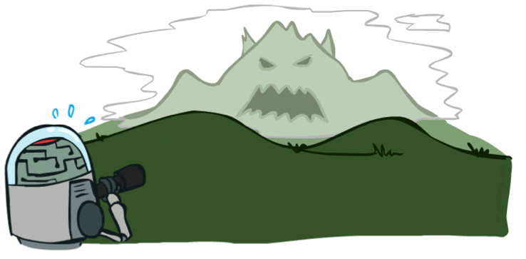

Depth Matters
Evaluation functions are always imperfect
The deeper in the tree the evaluation function is buried, the less the quality of the evaluation function matters
An important example of the tradeoff between complexity of features and complexity of computation
[Demo: depth limited (L6D4, L6D5)]

Slide 40
Video of Demo Limited Depth (2)

Slide 41
Video of Demo Limited Depth (10)

Slide 42
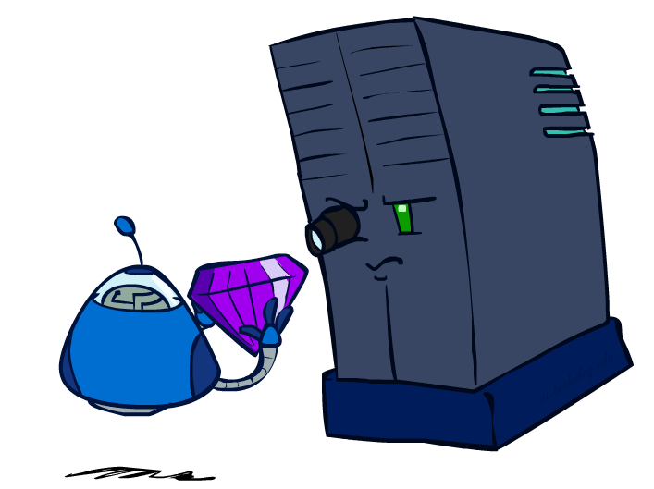
Evaluation Functions

Slide 43
Evaluation Functions
Evaluation functions score non-terminals in depth-limited search
Ideal function: returns the actual minimax value of the position
In practice: typically weighted linear sum of features:
e.g. f₁(s) = (num white queens – num black queens), etc.

Slide 44




Evaluation for Pacman
[Demo: thrashing d=2, thrashing d=2 (fixed evaluation function), smart ghosts coordinate (L6D6,7,8,10)]

Slide 45
Video of Demo Thrashing (d=2)

Slide 46
Why Pacman Starves
A danger of replanning agents!
He knows his score will go up by eating the dot now (west, east)
He knows his score will go up just as much by eating the dot later (east, west)
There are no point-scoring opportunities after eating the dot (within the horizon, two here)
Therefore, waiting seems just as good as eating: he may go east, then back west in the next round of replanning!

Slide 47
Video of Demo Thrashing -- Fixed (d=2)

Slide 48
Video of Demo Smart Ghosts (Coordination)

Slide 49
Video of Demo Smart Ghosts (Coordination) – Zoomed In

Slide 50
Iterative Deepening
Iterative deepening uses DFS as a subroutine:
Do a DFS which only searches for paths of length 1 or less. (DFS gives up on any path of length 2)
If “1” failed, do a DFS which only searches paths of length 2 or less.
If “2” failed, do a DFS which only searches paths of length 3 or less.
….and so on.
Why do we want to do this for multiplayer games?
Note: wrongness of eval functions matters less and less the deeper the search goes!
b
…

